Slide 1



X
Machine Learning Final Project
Data Scientist – Kalbe Nutritionals
Reza Lailul Farobi

Slide 2



Experience
Reza Lailul Farobi
Program Kreativitas Mahasiswa 2021
Melakukan riset interaksi protein dengan substrat untuk inhibisi SARS-CoV-2 melalui molecular docking/simulasi komputer
Studi Independen Kampus Merdeka – RevoU : Product, Sales, Marketing, Data
About You
Mempelajari Understanding Bussiness, Data Cleaning, Data Visualization and Communication
Chemist and data enthusiast that have high curiosity and eager to learn something

Slide 3
Contents
PROBLEM DEFINITION & PLANNING
Setting objective that based on problem statement and availability of dataset. Also, describe step of analysis.
04
DATA MODELING
Working to make predictive data model with regression and make machine learning data clustering
01
03
DATA ANALYSIS
Ingesting dataset to tools and make a explanatory data analysis based on objective.
.
DATA VISUALIZATION
Ingesting data to data visualizer and make data dashboard.
02

Slide 4
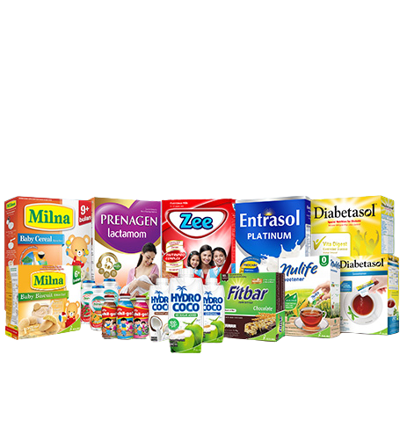
Business Overview
Kalbe is one of biggest FMCG business in Indonesia, which also has a great reputation nation wide and international market. Kalbe Nutritionals is part of Kalbe that have a focus on producing nutrition products. There are 10+ products in Kalbe Nutritionals production, such as Milna, Diabetasol, Zee, Fitbar, Hydro Coco, etc.

Slide 5





Project Overview
Inventory Team
Marketing Team
Objective:
Make prediction use regression about daily product sales quantity so inventory team can make sufficient daily stock.
Objective:
Make customer cluster/segment based on some criteria so marketing team can make right personalized promotion and sales treatment
Tools

Slide 6
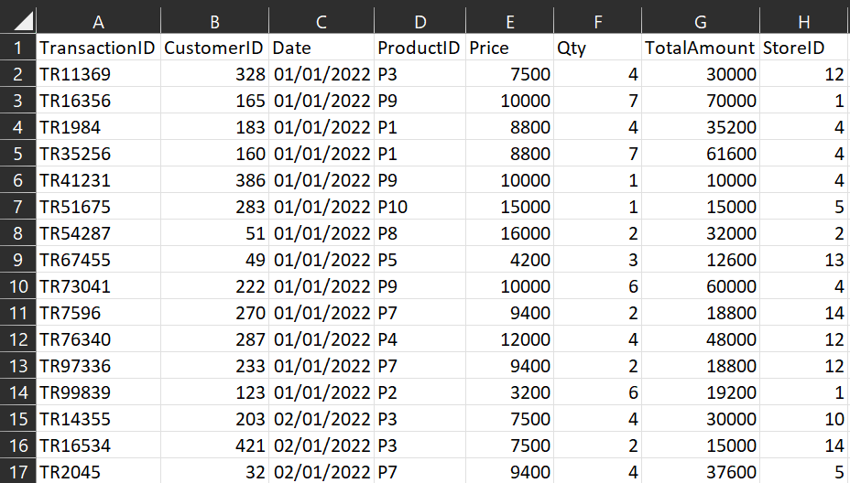
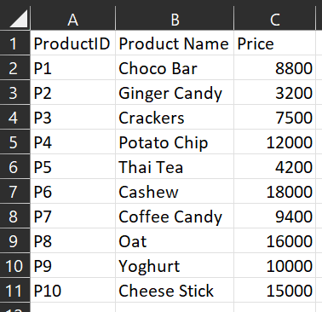
Dataset
Transaction
Product

Slide 7
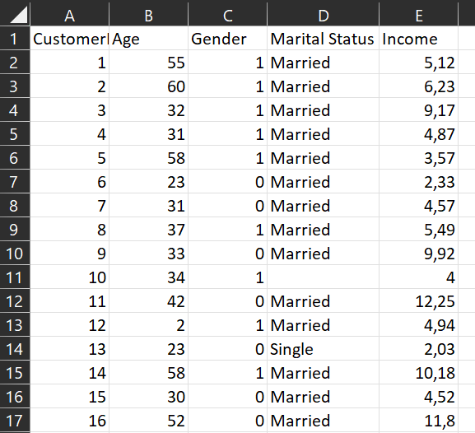
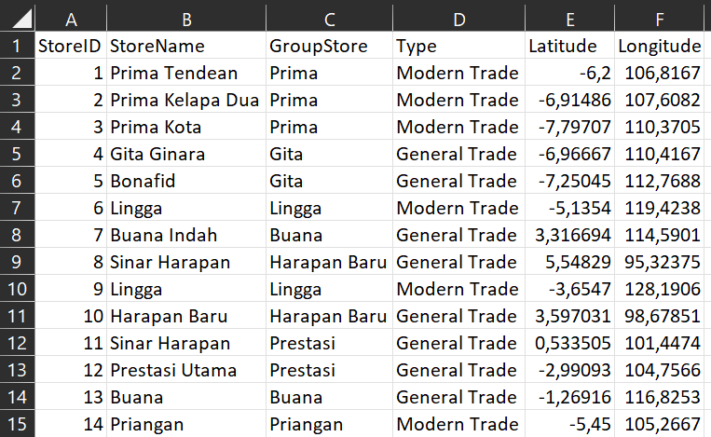
Dataset
Customer
Store

Slide 8
Data Analysis
Data Ingestion to DBeaver
Explanatory Data Analysis
Query 1 | : | What is the customer average age based on marital status
Query 2 | : | What is the customer average age based on gender
Query 3 | : | Determine the name of store with the most sales quantity
Query 4 | : | Determine the name of product with the most total amount

Slide 9
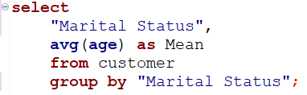
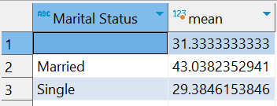
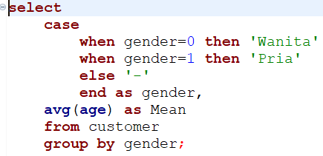
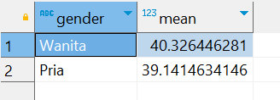
Data Analysis
Query 1
Result 1
Query 2
Result 2

Slide 10
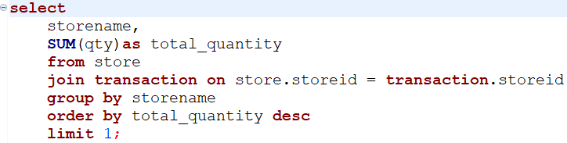
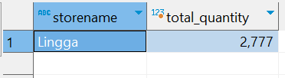
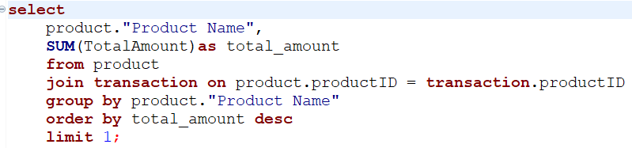
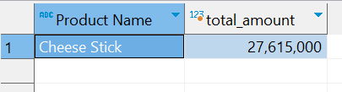
Data Analysis
Query 3
Result 3
Query 4
Result 4

Slide 11
Data Visualization
Data Ingestion to Tableau Public
Making Worksheet
Worksheet 1 | : | Total quantity per month
Worksheet 2 | : | Total amount day by day
Worksheet 3 | : | Total sales quantity by product
Worksheet 4 | : | Total amount by store name
3. Making Dashboard

Slide 12
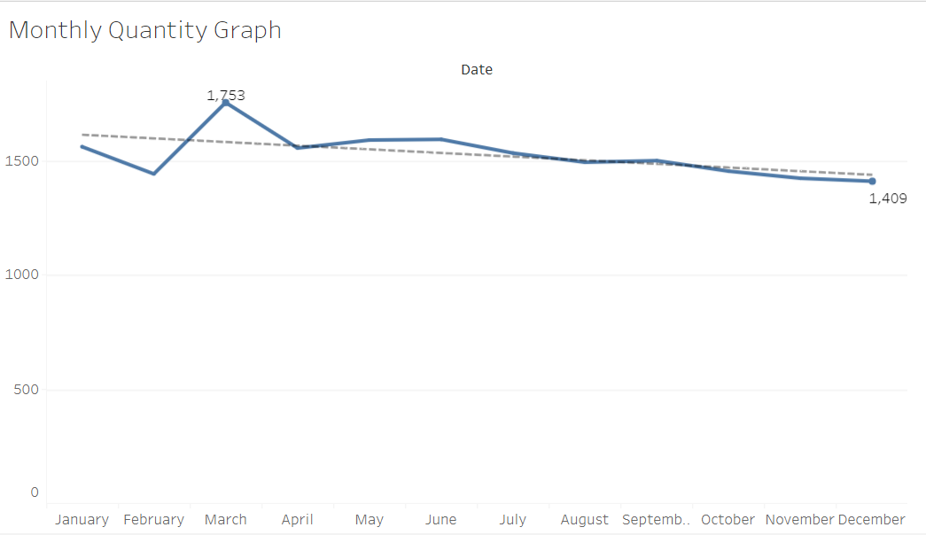
Data Visualization
Worksheet 1
Key Insight:
Month with the highest sales quantity is March with 1753 total sales quantity
Month with the lowest sales quantity is December with 1409 total sales quantity
Average total sales in 2022 is 1524

Slide 13
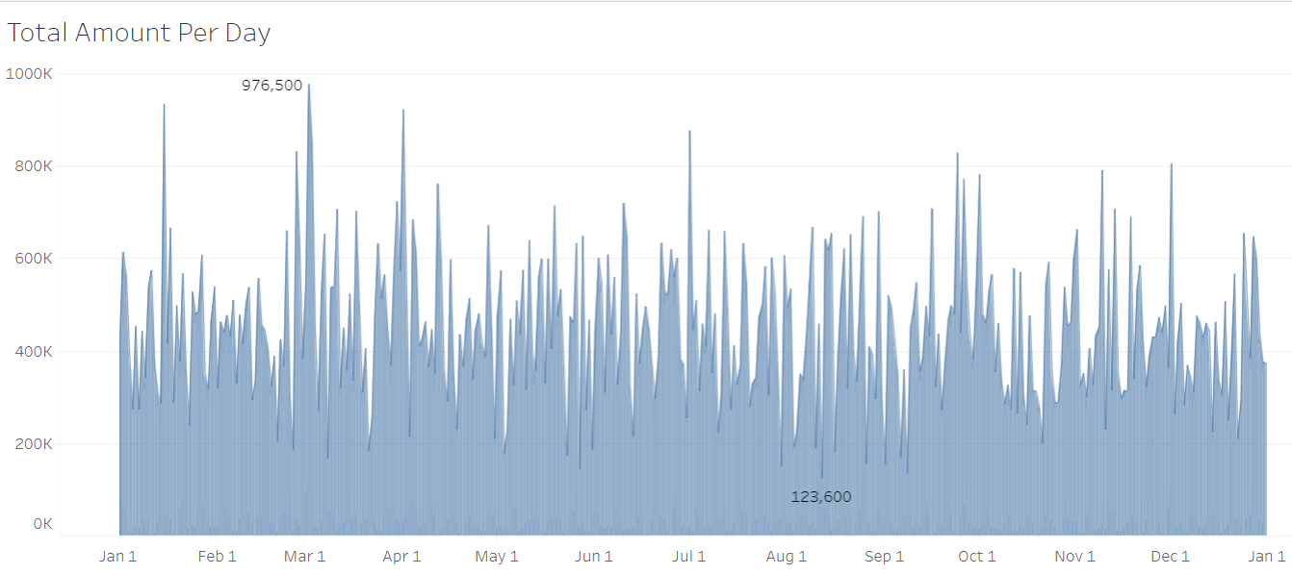
Data Visualization
Worksheet 2
Key Insight:
Date with the highest total amount is 02/03/2022 with 976.500 total amount
Date with the lowest total amount is 08/12/2022 with 123.600 total amount
Average total amount in 2022 is 32.279,48

Slide 14
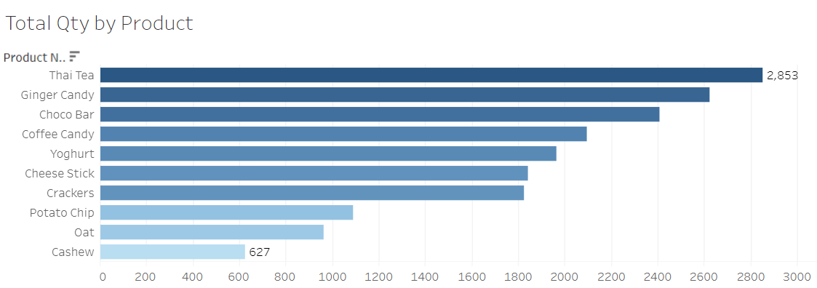
Data Visualization
Worksheet 3
Key Insight:
Product with the highest sales quantity is Thai Tea with 2853 total sales
Product with the lowest sales quantity is Cashew with 627 total sales

Slide 15
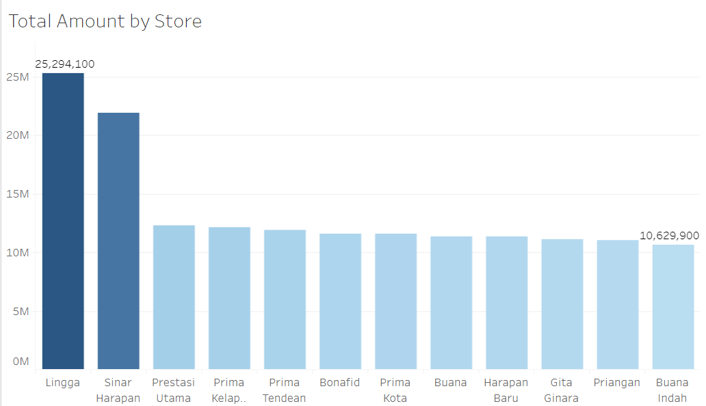
Data Visualization
Worksheet 4
Key Insight:
Store with the highest total amount is Lingga with 25.294.100 total amount
Store with the lowest total amount is Buana Indah with10.629.900

Slide 16
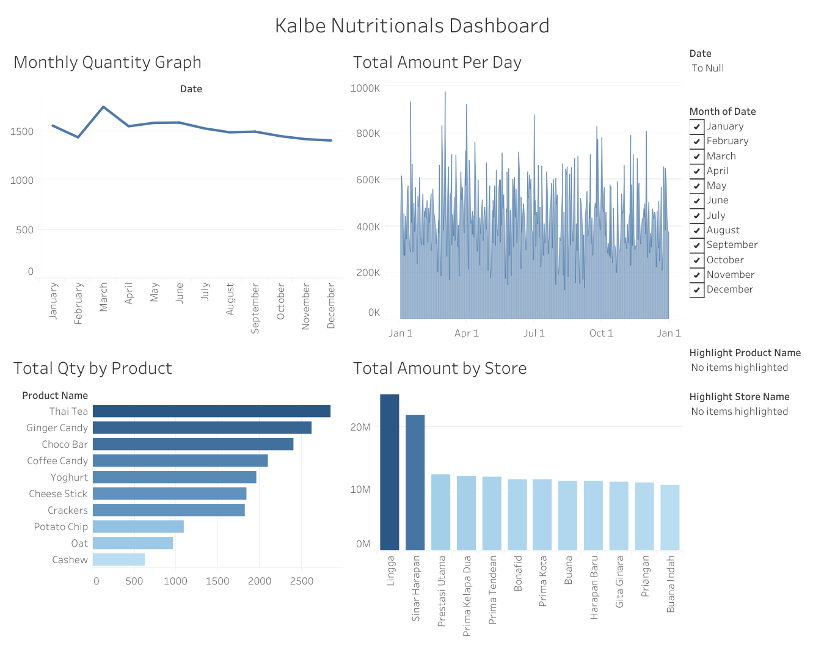
Worksheet 4

Slide 17
Data Modeling
Data Reading
Data Cleansing
Data Grouping
Machine Learning Regression (Time Series)
Machine Learning Clustering

Slide 18
Result
Reza Lailul Farobi_Kalbe

Slide 19
Github File
File Github Project Akhir VIX Rakamin x Kalbe

Slide 20
Presentation Video
Video Presentasi

Slide 21
Thank You
X

